Slide 1
Solihull’s Examples of Equity in Experience
24 September 2026
Jo Jackson Reablement Team Manager, Lead Team Manager for Equality, Diversity and Inclusion
Notes:
Hi, I’m Jo and I have a small presentation of the work Solihull has been doing to meet it’s changing demographics. I’ll end with some pop vox videos form our Learning Disability community about experiences they have had working with us.

Slide 2
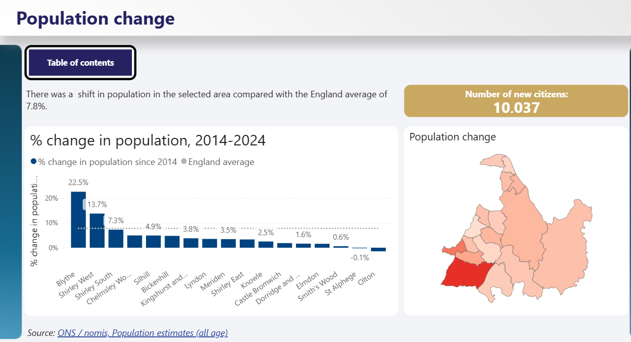
Solihull through local data
3 key themes for Solihull
Solihull is becoming increasingly ethnically diverse
Solihull has a relative old and ageing population
Financial hardship is an important driver of rising service demand
  Power BI
Notes:
Although there is a shift taking place in Solihull’s demographics so we are now similar to national averages in diversity we are still less diverse than our neighbours in Coventry and Birmingham.
Solihull has: [ons.gov.uk], [censuswise.com]
More people aged 50 and over than the national average.
A larger proportion of residents aged 65+ (21%) than the England and Wales figure of 18.6%. This is expected to continue to grow.
Fewer young adults aged 16-24 and fewer working-age adults aged 25-49 than the national picture. A slightly higher proportion of children than the England and Wales average.

Slide 3
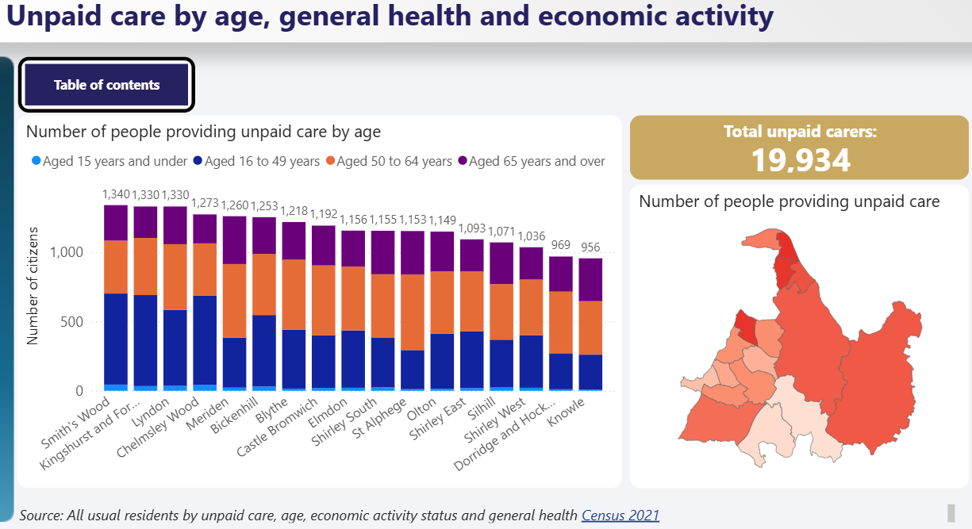
Carer’s by age and area
Notes:
The impact of an aging population is also an impact for informal carers in the population.
As adult services we are therefore working closely with our carers to get the offer right and support this part of our population.
Carer’s board
Carer’s trust
All staff engaging in and asking about carer needs and knowing what the offer is to address them.

Slide 4
Safeguarding Board’s work to engage.
Solihull Faith Forum
A Hindu temple in Birmingham
The Hong Kong community
Age UK Solihull Social Café
RNIB
These were learning and listening to these communities to understand what their knowledge of safeguarding is and how they would find help if they are in difficulties.
How to best present information
What information is key
How to enable them to come to Adult Social Care when they needed assistance
Notes:
The highlights from this is that
Need for multimedia formats for information
Need to get Solihull information to Birmingham community hubs
The importance of ongoing engagement – constant learning and listening
The value of building our co-production activity.

Slide 5
Co-production
Features Richard and Keith, Chair and Co-chair of the Learning Disability Partnership Board, discussing how they influence local services and improve opportunities for people with a learning disability

Slide 6
In-house day opportunities
Features Derek and Inderjit sharing their experiences of friendship, learning and community at Colebrook Day Centre in Chelmsley Wood.

Slide 7
Independent sector day opportunities
Features Sandy from Newlands Bishop Farm talking about growing the hanging baskets displayed across the borough.

Slide 8

Any questions?

